Slide 2
Antra SEP Program
Oracle
Day 2

Slide 3
DAY 2
Session 1
Data Definition Language (DDL).
Data Modification Language (DML).
Session 2
Transaction Control Language (TCL).
Data Control Language (DCL).
Constraints.

Slide 4
Data Definition Language

Slide 5
Data Definition Language
Table names and column names:
Must begin with a letter
Must be 1 to 30 characters along
Must contain only A-Z, a-z, 0-9, _, $, and #
Must not be an Oracle server reserved word

Slide 6
Data Definition Language
You must have:
Create Table privilege
A storage area
CREATE TABLE [schema. ] table
(column datatype [DEFAULT expr] [, …])
You specify:
Table name
Column name, column data type, and column size

Slide 7
Data Definition Language
Default Option
Specify a default value for a column during an INSERT operation.
… hire_date DATE DEFAULT SYSDATE, …
Literal values, expressions, or SQL functions are legal values.
Another column’s name or a pseudocolumn are illegal values.
The default data type must match the column data type.

Slide 8
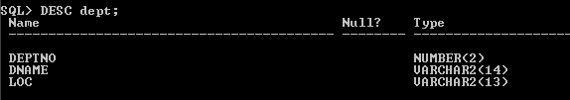
Data Definition Language
Creating Table
CREATE TABLE dept
(deptno NUMBER (2),
dname VARCHAR2 (14)
loc VARCHAR2 (13)) ;
TABLE created.
Conformation Of Created table

Slide 9
Data Definition Language
Kinds Of Tables In A Data Base
User tables:
Are a collection of tables created and maintained by the user
Contain user information
Data Dictionary:
Is a collection of tables created and maintained by the oracle server
Contain database information

Slide 10
Data Definition Language
Viewing Info from Dictionary Tables
See the names of tables owned by the user.
SELECT table_name
FROM user_tables;

Slide 11
Data Types
Data type | Description
VARCHAR2 (size) | Variable-length character data
CHAR [ (size)] | Fixed-length character data
NUMBER [ (p,s)] | Variable-length numeric data
DATE | Date and time values
LONG | Variable-length character data up to 2 gigabytes
CLOB | Character data up to 4 gigabytes
RAW AND LONG RAW | Raw binary data
BLOB | Binary data up to 4 gigabytes
BFILE | Binary data stored in an external file; up to 4 gigabytes
ROWID | Hexadecimal string representing the unique address of a row in its table

Slide 12
Creating Table using Sub query
Syntax
CREATE TABLE table
[ (column, column …) ]
As subquery;
SQL>CREATE TABLE dept1
AS
SELECT * FROM dept;
Table created

Slide 13
Creating Table using Sub query (Selective Columns)
SQL>CREATE TABLE emp1
AS
SELECT ename, job, sal
FROM emp;
Table created

Slide 14
Using Alter Table Statement
Use the ALTER TABLE Statement to:
Add a new column.
Modify an existing column.
Define a default value for the new column.
Drop a column.

Slide 15
Using Alter Table Statement
Adding a New Column
Syntax:
ALTER TABLE table
ADD column datatype [Default expr]
[ , column datatype] …) ;
SQL>ALTER TABLE EMP1
ADD dname varchar2(15) default ‘Accounts’;
Table altered.

Slide 16
Using Alter Table Statement
Modifying a Column
Syntax:
ALTER TABLE table
MODIFY ( column Datatype [Default expr]
[ , column datatype] …) ;
SQL>ALTER TABLE EMP1
MODIFY dname varchar2(20) default ‘Admin’;
Table altered.

Slide 17
Using Alter Table Statement
Modifying a Column
Syntax:
ALTER TABLE table
DROP COLUMN ( column ) ;
SQL>ALTER TABLE EMP1
DROP COLUMN dname;
Table altered.

Slide 18
Droping a Table
All data and structure in the table is deleted.
Any pending transactions are committed.
All indexes are dropped.
You cannot roll back the DROP TABLE statement
SQL>DROP TABLE emp1;
Table altered.

Slide 19
Changing Name of an object
SQL> Rename dept TO detail_dept;
Table renamed.
Table altered

Slide 20
TRUNCATING A Table
The TRUNCATE TABLE statement:
Removes all rows from a table
Releases the storage space used by that table
TRUNCATE TABLE detail_dept;
Table truncated.
You cannot roll back row removal when using TRUNCATE.
Alternatively, you can remove rows by using the DELETE statement.

Slide 21
Adding Comments to A Table
SQL>COMMENT ON TABLE emp
IS ‘Employees information’;
Comment created.
SQL>COMMENT ON COLUMN emp.mgr
IS ‘Employees Manager ID’
Comment created.

Slide 22
Data Dictionary Views
Comments can be viewed through the data dictionary views:
ALL_COL_COMMENTS.
USER_COL_COMMENTS.
ALL_TAB_COMMENTS.
USER_TAB_COMMENTS

Slide 23
Data Definition Language
Viewing Info from Dictionary Tables
SQL>SELECT * FROM USER_COL_COMMENTS
WHERE TABLE_NAME=‘EMP1’;

Slide 24
Data Manipulation Language

Slide 25
DML
A DML statement is executed when you:
Add new rows to a table.
Modify existing rows in a table.
Remove existing rows from a table
A transaction consists of a collection of DML statements that from a logical unit of work.

Slide 26
DML
Inserting New Records Into A Table
Add new rows to a table by using the INSERT statement.
INSERT INTO table [ (column [ , colum… ]) ]
Values ( Value [ , Value…] );
Only one row is inserted at a time with this syntax.

Slide 27
DML
Inserting New Records Into A Table
SQL> INSERT INTO dept
VALUES(50,’EXECUTIVE’,STERLING’);
1 row created.
List values in the default order of the columns in the table.
Enclose character and date values within single quotation marks.

Slide 28
DML
Inserting NULL values
SQL> INSERT INTO EMP(empno,ename,job,hiredate,comm)
VALUES(1234,SYAM’,’MANAGER’,sysdate,NULL);
1 row created

Slide 29

DML
Using Script:
SQL> INSERT INTO EMP(empno,ename,job)
VALUES(&empno,’&ENAME’,’&JOb’);
1 row created

Slide 30
DML
Copying rows from another table:
SQL> INSERT INTO EMP1(empno,ename,job,sal)
SELECT empno,ename,job,sal
FROM emp
WHERE job=‘MANAGER’;
3 rows created.

Slide 31
DML
Changing data in a Table;
Modify existing rows with the update statement.
UPDATE table SET column=value [, column=value …] [WHERE condition];
Update more than one row at a time, if required.

Slide 32
DML
Changing data in a table;
SQL> UPDATE emp
SET ename=‘STEVE’
WHERE empno=7654; 1 row updated.

Slide 33
DML
Changing data in a table;
SQL> UPDATE emp
SET job=(SELECT job
FROM emp
WHERE ename=‘STEVE’),
sal=(SELECT sal
FROM emp
WHERE ename=‘STEVE’),
WHERE ename=‘SCOTT’;
1 row updated.

Slide 34
DML
Deleting Records From A Table;
You can remove existing rows from a table by using the DELETE statement.
DELETE [ FROM ] table
[ WHERE Value…] ;

Slide 35
DML
Deleting Records From A Table;
SQL> DELETE FROM EMP
WHERE empno=7654;
1 row deleted
SQL> DELETE DEPT;
4 rows deleted.

Slide 36
DATABASE TRANSACTIONS

Slide 37
TCL
Transcations
Begin when the first DML SQL statement is executed
End with one of the following events:
A COMMIT or ROLLBACK statement is issued
A DDL or DCL statement executes (automatic commit)
The user exits isql *Plus
The system crashes

Slide 38
TCL
Advantages of COMMIT & ROLLBACK
With COMMIT and ROLLBACK statements, you can:
Ensure data consistency
Preview data changes before making changes permanent
Group logically related operations

Slide 39
TCL
Controlling Transactions
Time
COMMIT
Transaction
DELETE
SAVEPOINT A
INSERT
UPDATE
SAVEPOINT B
INSERT
ROLLBACK
To SAVEPOINT B
ROLLBACK
To SAVEPOINT A
ROLLBACK

Slide 40
TCL
Controlling Transactions
Create a marker in a current transaction by using the SAVEPOINT statement.
Roll back to that marker by using the ROLLBACK TO SAVEPOINT statement.
UPDATE…
SAVEPOINT update_done;
Savepoint created
INSERT
ROLLBACK TO update_done
Rollback complete.

Slide 41
TCL
Implicit Transaction Processing
An automatic commit occurs under the following circumstances
DDL statement is issued
DCL statement is issued
Normal exit from iSQL*Plus, without explicitly issuing COMMIT or ROLLBACK statements
An automatic rollback occurs under an abnormal termination of iSQL*Plus or a system failure.

Slide 42
TCL
State of Data Before Commit or Rollback;
The Previous state of the data can be recovered.
The current user can review the results of the DML operations by using the SELECT statement.
Other users cannot view the results of the DML statements by the current user
The affected rows are locked; other users cannot change the data within the affected rows.

Slide 43
TCL
State of Data After Commit;
Data changes are made permanent in the database.
The Previous state of the data is permanently lost.
All user can view the results.
Locks on the affected rows are released; those rows are available for other users to manipulate.
All savepoints are erased.

Slide 44
TCL
State of Data After Rollback;
Discard all pending changes by using the ROLLBACK statement:
Data changes are undone.
Previous state of the data is restored.
Locks on the affected rows are released.

Slide 45
TCL
Statement Level Rollback;
If a single DML statement fails during execution, only that statement is rolled back.
The oracle Server implements an implicit savepoint.
All other changes are retained.
The user should terminate transactions explicitly by executing a COMMIT or ROLLBACK statement.

Slide 46
Transactions
Transaction must exhibit ACID Properties
Atomicity
Consistency
Isolation
Durability

Slide 47
TCL
ACID properties
Atomicity
Work is atomic
Either all of the work is done or nothing
Consistency
Data must be in consistent state
Maintains data integrity
Correctness of Internal data structure

Slide 48
TCL
ACID properties
Isolation
Modification done by concurrent transaction must be isolated
Durability
The effects of the transaction stored in the system permanently for further use.

Slide 49
TCL
Data Concurrency and Consistency
Data concurrency means that many users can access data at the same time.
Data consistency means that each user sees a consistent view of the data, including visible changes made by the user’s own transactions and transactions of other users

Slide 50
TCL
Read Consistency
Read consistency guarantees a consistent view of the data at all the times.
Changes made by one user do not conflict with changes made by another user.
Read consistency ensures that on the same data:
Readers do not wait for writers
Writers do not wait for readers

Slide 51
The isolation models prevents following concurrency problems
Dirty Reads
Lost Update
Non- Repeatable Reads
Phantom Reads

Slide 52
Isolation Levels control
Isolation Levels | Lost Updates | Dirty Reads | Non Repeatable Reads | Phantom Reads
Read uncommitted | Y | Y | Y | Y
Read committed | Y | N | Y | Y
Repeatable read | N | N | N | Y
Serializable | N | N | N | N

Slide 53
Oracle Isolation Levels
Read committed | Each query executed by a transaction sees only data that was committed before the query began (Oracle default isolation level)
Serializable | Serializable transactions see only those changes that were committed at the time the transaction began, plus its own changes
Read-only | The transaction sees only those changes that were committed at the time the transaction began and do not allow any DML statement

Slide 54
Set Isolation Level
You can set the isolation level of a transaction by using one of these statements at the beginning of a transaction:
SET TRANSACTION ISOLATION LEVEL READ COMMITTED;
SET TRANSACTION ISOLATION LEVEL SERIALIZABLE;
SET TRANSACTION ISOLATION LEVEL READ ONLY;

Slide 55
Data Control Language

Slide 56
Object Privileges
Object privileges vary from object to object.
An owner has all the privileges on the object.
An owner can give specific privileges on that owner’s object.
GRANT object_priv
ON object
TO {user l role l PUBLIC}
[WITH GRANT OPTION];

Slide 57
DCL
Granting Select privilege on SCOTT user
SQL> GRANT SELECT ON emp to SCOTT;
Grant succeeded
Granting Update Privilege on Emp to user SCOTT & STEVE
SQL> GRANT UPDATE ON emp to SCOTT,STEVE;
Grant succeeded.

Slide 58
Object Privileges
Granting Privileges to Update specific columns to Users
SQL> GRANT UPDATE(sal,job) ON emp
TO SCOTT,STEVE;
Grant succeeded.
Granting ALL Privileges to SCOTT User
SQL> GRANT ALL ON emp to SCOTT
Grant succeeded.

Slide 59
Using with Grant and Public Keywords
Granting a User Authority To Pass On Privileges:
SQL> GRANT SELECT,INSERT ON dept
TO SCOTT
WITH GRANT OPTION;
Grant Succeeded.
Granting All Users in the Database to access Data from Dept Table
SQL> GRANT SELECT ON dept to PUBLIC;
Grant Succeeded.

Slide 60
Confirming Privileges Granted
Data Dictionary | Description
ROLE_SYS_PRIVS | System privileges granted to roles
ROLE_TAB_PRIVS | Table privileges granted to roles
USER_ROLE_PRIVS | Roles accessible by the user
USER_TAB_PRIVS_MADE | Object privileges granted on the user’s objects
USER_TAB_PRIVS_RECD | Object privileges granted to the user
USER_COL_PRIVS_MADE | Object privileges granted on the columns of the user’s objects
USER_COL_PRIVS_RECD | Object privileges granted to the user on specific columns
USER_SYS_PRIVS | Lists system privileges granted to the user

Slide 61
Revoking Privileges Granted
You use the REVOKE statement to revoke privileges granted to other users.
Privileges granted to others through the WITH GRANT OPTION clause are revoked.
REVOKE {privilege [, privilege…] l ALL}
ON object
FROM {user [, user…] l role l PUBLIC}
[CASCADE CONSTRAINTS];

Slide 62
Object Privileges
Revoking Select Privilege on Emp From SCOTT user
SQL> REVOKE SELECT ON emp FORM SCOTT;
Revoke succeeded.
Revoking Update Privilege on Emp From SCOTT & STEVE
SQL> REVOKE UPDATE ON emp FROM SCPTT, STEVE;
Revoke succeeded.

Slide 63
Constraints

Slide 64
Constraints
Constraints enforce rules at the table level.
Constraints prevent the deletion of a table if there are dependencies.
The following constraint types are valid:
NOT NULL
UNIQUE
PRIMARY KEY
FOREIGN KEY
CHECK

Slide 65
Constraints
Syntax
CREATE TABLE [schema. ] table
(column datatype [DEFAULT expr]
[column_constraint],
…
[table_constraint] [,…]);

Slide 66
Constraints
SQL>CREATE table student (sno number(3),
sname varchar2(20) constraint std_sname_u unique,
smarks number(3))
Table created.

Slide 67
Constraints At Column & Table Level
Column constraint level:
Column [CONSTRAINT constraint_name] constraint_type,
Table constraint level:
Column,…
[CONSTRAINT constraint_name] constraint_type, (column,…)

Slide 68
Constraints At Column & Table Level
SQL>CREATE table student (sno number(3) not null,
sname varchar2(20) constraint std_sname_u unique,
smarks number(3),
sage number(3) check(sage<120),
constraint std_smarks_c check(smarks<=600 ));
Table created.

Slide 69
Unique Constraint
Is defined at either the table level or column level
CREATE TABLE employees(
employee_id NUMBER (6)
last_name VARCHAR2 (25) NOT NULL
email VARCHAR2 (25) ,
salary NUMBER (2,2) ,
commission_pct NUMBER (2 ,2),
hire_date DATE NOT NULL,
…
CONSTRAINT emp_email_uk UNIQUE (email))…

Slide 70
Primary Key Constraint
Is defined at either the table level or the column level
CREATE TABLE departments(
department_id NUMBER (4)
department_name VARCHAR (30) ,
CONSTRAINT dept_name_nn NOT NULL,
manager_id NUMBER (6) ,
location_id NUMBER (4),
CONSTRAINT dept_id_pk PRIMARY KEY (department)) ;…

Slide 71
Foreign Key Constraint
Is defined at either the table level or the column level
CREATE TABLE departments(
employee_id NUMBER (6)
last_name VARCHAR2 (25) NOT NULL ,
email VARCHAR2 (25) ,
manager_id NUMBER (8,2) ,
commission_pct NUMBER (2,2),
hire_data DATE NOT NULL,
…
department_id NUMBER (4)
CONSTRAINT emp_dept_fk FOREIGN KEY (department_id)
REFERENCES departments (department_id),
CONSTRAINT emp_email_uk UNIQUE (email));

Slide 72
Foreign Key Constraint
FOREIGN KEY: Defines the column in the child table at the table constraint level
REFERENCES: Identifies the table and column in the parent table
ON DELETE CASCADE: Deletes the dependent rows in the child table when a row in the parent table in deleted.
ON DELETE SET NULL: Converts dependent foreign key values to null

Slide 73
Add a Constraint
Use the ALTER TABLE statement to:
Add or drop a constraint, but not modify its structure
Enable or disable constraints
Add a NOT NULL constraint by using the MODIFY clause
ALTER TABLE table
ADD [CONSTRAINT constraint] type (column);

Slide 74
Droping a Constraint
Remove the manager constraint from the EMPLOYEES table
ALTER TABLE employees
DROP CONSTRAINT emp_manager_fk;
Remove the PRIMARY KEY constraint on the DEPARTMENTS table the associated FOREIGN KEY constraint on the EMPLOYEES. DEPARTMENT_ID column.
ALTER TABLE departments
DROP PRIMARY KEY CASCADE;
Table altered.

Slide 75
Disabling a Constraint
Execute the DISABLE clause of the ALTER TABLE statement to deactivate an integrity constraint.
Apply the CASCADE option to disable dependent integrity constraints.
ALTER TABLE employees
DISABLE CONSTRAINT emp_emp_id_pk CASCADE
Table altered.

Slide 76
Enabling a Constraint
Active an integrity constraint currently disabled in the table definition by using the ENABLE clause.
ALTER TABLE employees
ENABLE CONSTRAINT emp_emp_id_pk;
Table altered.
A UNIQUE index is automatically created if you enable a UNIQUE key or PRIMARY KEY constraint.

Slide 77
Viewing a Constraint
Query the USER_CONSTRAINTS table to view all constraint definitions and names.
SELECT constraint_name, constraint_type, search_condition
FROM user_constraints
WHERE table_name = ‘EMPLOYEES’ ;

Slide 78
Viewing Columns Associated With Constraint
View the columns asscociated with constraint name in the USER_CONS_COLUMNS view.
SELECT constraint_name, column_name
FROM user_cons_columns
WHERE table_name = ‘EMPLOYEES’ ;

Slide 79
Session 1
Joins.
SQL:1999 Compliant Joins
Session 2
Sub Queries
Producing Readable Output With SQL *Plus.

Slide 80
Joins

Slide 81
Types of Joins
Equijoin
Nonequijoin
Outer join
Self join

Slide 82
TYPES OF JOINS
SQL:1999 Compliant Joins
Cross joins
Natural joins
Using clause
Full or two sided outer joins

Slide 83
JOINS
CARTESIAN PRODUCT

Slide 84
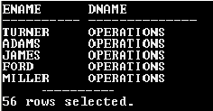
JOINS
CARTESIAN PRODUCT
SQL>SELECT ename,dname
FROM emp,dept;

Slide 85
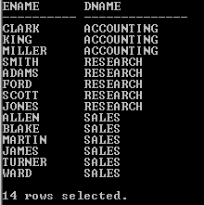
JOINS
EQUI JOIN
SQL>SELECT ename,dname
FROM emp,dept
WHERE emp.deptno=dept.deptno;

Slide 86
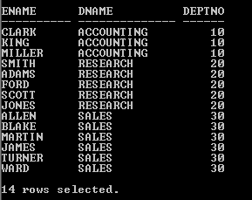
JOINS
EQUI JOIN
SQL>SELECT ename,dname ,emp.deptno
FROM emp,dept
WHERE emp.deptno=dept.deptno;

Slide 87
JOINS
EQUI JOIN
SQL>SELECT emp.ename,dept.dname ,emp.deptno
FROM emp,dept
WHERE emp.deptno=dept.deptno;

Slide 88
JOINS
EQUI JOIN Using table aliases
SQL>SELECT e.ename,d.dname ,e.deptno
FROM emp e,dept d
WHERE e.deptno=d.deptno;

Slide 89
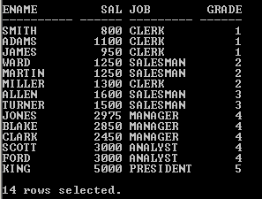
JOINS
NON- EQUI JOIN
SQL>SELECT e.ename,e.sal,e.job,s.grade
FROM emp e,salgrade s
WHERE sal between losal and hisal;

Slide 90
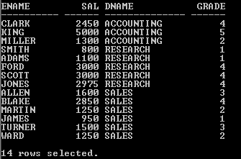
JOINS
JOINING MORE THAN TWO TABLES:
SQL>SELECT e.ename,e.sal,d.dname,s.grade
FROM emp e,salgrade s,dept d
WHERE e.deptno=d.deptno
and sal between losal and hisal;

Slide 91
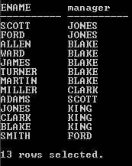
JOINS
SELF JOIN
SQL>SELECT a.ename,b.ename as “manager”
FROM emp a, emp b
WHERE a.mgr=b.empno;

Slide 92
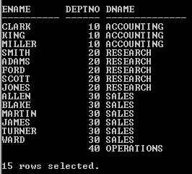
Outer Joins
Left Outer Join
SQL>SELECT e.ename,d.deptno,d.dname
FROM emp e, dept d
WHERE d.deptno=e.deptno(+);

Slide 93
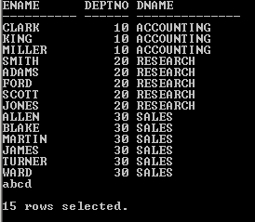
Outer JOINS
Right Outer Join
SQL>SELECT e.ename,d.deptno,d.dname
FROM emp e, dept d
WHERE d.deptno(+)=e.deptno;

Slide 94
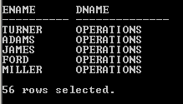
SQL Compliant 1999 Joins
Cross Join
SQL>SELECT ename,dname
FROM Emp cross join dept;

Slide 95
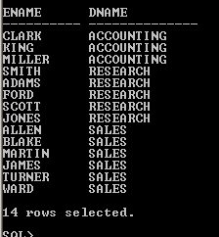
SQL Compliant 1999 Joins
Natural Join
SQL>SELECT ename,dname
FROM Emp natural join dept;

Slide 96
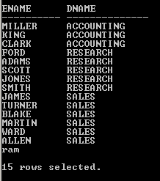
Left Outer Join
SQL>SELECT e.ename,d.dname
FROM Emp e left outer join dept d
ON (e.deptno=d.deptno);

Slide 97
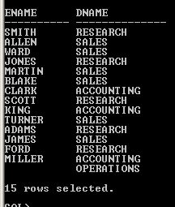
Right Outer Join
SQL>SELECT e.ename,d.dname
FROM Emp e right outer join dept d
ON (e.deptno=d.deptno);

Slide 98
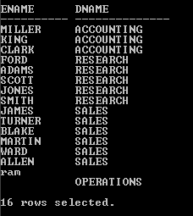
Full Outer Join
SQL>SELECT e.ename,d.dname
FROM Emp e full outer join dept d
ON (e.deptno=d.deptno);

Slide 99
Sub Queries

Slide 100
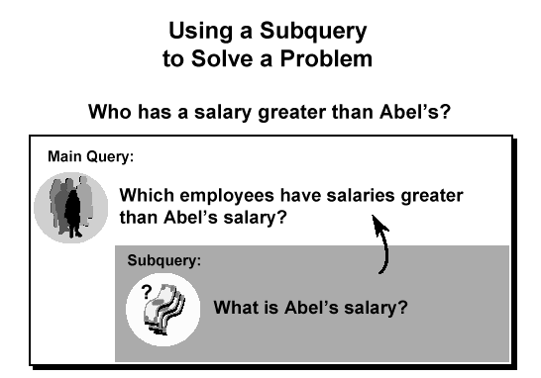
SUBQUERIES
Using a Subquery
To solve a problem
Who has a salary greater than Abel’s?

Slide 101
SUBQUERIES
Syntax
SELECT employees
FROM table
WHERE expr operator
(SELECT select_list
FROM table) ;
The subquery (inner query) executes once before the main query.
The result of the subquery is used by the main query (outer query).

Slide 102
SUBQUERIES
Types Of Subqueries
Single-row Subquery
Multiple-row subquery
Main query
returns
Subquery
ST_CLERK
Main query
returns
ST_CLERK
SA_MAN
Subquery

Slide 103
SUBQUERIES
Single Row Subqueries
Return only one row
Use single-row comparison operators
Operator | Meaning
= | Equal to
> | Greater than
>= | Greater than or equal to
< | Less than
<= | Less than or equal to
<> | Not equal to

Slide 104

SUBQUERIES
Single Row Subqueries
List the employees whose job is same as scott
SQL>SELECT ename,job,sal
FROM emp
WHERE job=(SELECT job
FROM emp
WHERE ename=‘SCOTT’)

Slide 105

Single Row Subqueries
Using group functions
List the employee details whose is earning minimum salary .
SQL>SELECT ename,job,sal
FROM emp
WHERE sal=(SELECT min(sal)
FROM emp)

Slide 106

Single Row Subqueries
Using group functions
Find the job with least average salary .
SQL>SELECT job,avg(sal)
FROM emp
GROUP BY job
HAVING avg(sal)=(SELECT min(avg(sal))
FROM emp
GROUP BY job)

Slide 107
Multiple Row Subqueries
Return more than one row
Use multiple-row comparison operators
Operator | Meaning
IN | Equal to any member in the list
ANY | Compare value to each value returned by the subquery
ALL | Compare value to every value returned by the subquery

Slide 108

Multiple Row Subqueries
List the employees who earn minimum salaries in their departments
SQL>SELECT ename,sal,deptno
FROM emp
WHERE sal in(SELECT min(sal)
FROM emp
GROUP BY deptno)

Slide 109

Multiple Row Subqueries
Using ANY Operator
List the employees who earns salaries less than any of the employees of job clerk category
SQL>SELECT ename,sal
FROM emp
WHERE sal <ANY(SELECT sal
FROM emp
WHERE job=‘CLERK’)
AND job<>’CLERK’;

Slide 110
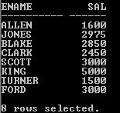
Using All Operator
List the employees who earns salaries greater than all the employees who are working as clerk
SQL>SELECT ename,sal
FROM emp
WHERE sal >ALL(SELECT sal
FROM emp
WHERE job=‘CLERK’)
AND job<>’CLERK’;

